Slide 1




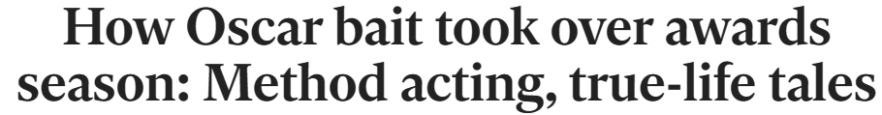
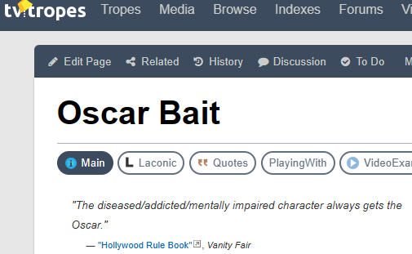
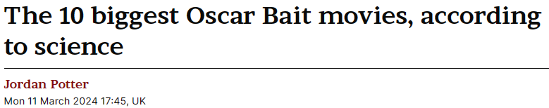
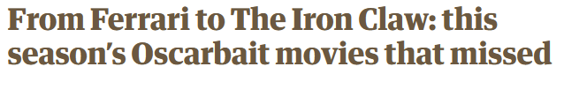
Do Movies with higher Box Office Revenue perform better at the Academy Awards?
Notes:
Now I don’t know if you were aware of this but the 96th Academy Awards, better known as the Oscars, took place on 10th March - just a couple of weeks ago. Of course, this dominated our conversation when we were working out a topic, when Athul posed the question *click* - Do Movies with higher Box Office Revenue perform better at the Academy Awards?
So we started looking into it, but as we sought out our initial data and did our preliminary research, one term kept coming up. *click until all headlines are visible, last one is centred and fades in*
“Oscar Bait” is a term that journalists love to use, describing movies released just before the awards season with the goal of picking up one of those prestigious trophies. But does that term carry weight? Does the idea of Oscar Bait create a bias amongst journalists with their reviews? Does it bring more people to the cinema? Do those “Oscar Bait” movies actually have more chance of picking up an award than movies released outside that October-December window?
Or, to simplify those questions into one overarching topic: *click to next slide*

Slide 2
Is ‘Oscar Bait’ real?
Team members:
Athul Madhusudhanan
Daniel Daniel
Essa Bostan
Mujahid Iqbal
James Hanson
Notes:
Is Oscar Bait Real? *Pause for a moment so people can read the team members names, then click to next slide*

Slide 3




What is it?
Films engineered to attract an Oscar nomination
Released shortly before the Oscar nominations close
Generally with a more serious tone
Enhance reputations of those involved
Notes:
First, we need to define what it is, so I did some reading and found some main elements that describe it, and can help to shape the data we need and the hypotheses we will be testing. *click* These movies are engineered with the goal of being nominated for an Oscar. *click* They’re usually released within two months of the nominations closing at the end of the year. *click* They often have a more serious tone *click* and they are often made to enhance the reputations of those involved. Specifically, we’ll be focusing on those first two points, although with more time, we could have also looked at genres and actors/directors over a number of years for further research.

Slide 4


The Academy
The organisation that hosts and decides the Academy awards
Various actors, writers, producers, and other craftsmen
Notes:
Who is the Academy?
The Academy of Motion Picture Arts and Sciences is the organisation that hosts and decides the Academy awards, colloquially known as the Oscars. The Academy consists of various actors, writers, producers, and other craftsmen and members in the Hollywood and Film industry.
What do they do?
The Academy are the ones who vote for the films that are nominated at the Oscars. They also vote for the winners. Not the general public.
Membership
To be member of the Academy, you cannot apply for it, you must be sponsored by someone who already has membership, unless you are a previous winner or nominee.

Slide 5
Hypotheses
Question:
Are movies released within two months of the Academy Awards Nominations window more likely to be nominated for an award?
Hypothesis:
If a movie is released within two months of the nominations closing, it is more likely to be nominated
Question:
Do movie review scores accurately reflect how a movie will perform at the Academy Awards?
Hypothesis:
If a movie receives high review scores, it is more likely to be nominated
Question:
Do movies released within two months of the Academy Awards Nominations window receive higher review scores than movies released outside of that window?
Hypothesis:
The later in the year a movie is released, the higher average review scores it will receive.
Notes:
So what will we be testing? *click* Well firstly asked whether movies being released shortly before the Academy Awards are actually being nominated for more Academy Awards. We can assess this with a pie chart showing the proportion of movies nominated for an award that are within that period or not, with a bar chart to show changes by month, and with a line chart showing the trend over a number of years. *click* Secondly we wanted to know if Review scores accurately reflect how a movie will perform at the Academy Awards. We can assess this with a box plot showing the quartiles and average of review scores, and then overlay the nominated movies to show how they compare to the average movie for Review score. *click* Finally we wanted to know whether movies released in that two month period before the Academy Awards nominations window closes receive higher review scores. We could compare this against our findings for the other questions to answer whether journalists have a bias towards movies released later in the year which may fuel the idea of “Oscar Bait”. We will test this with a Scatter Plot with a Linear Regression line to show the trend of review scores through the year. Each question will have plots for 3 different years, so we can see whether there have been any changes to this trend over time, and take into account how external factors like Streaming may have impacted the Academy Awards.

Slide 6
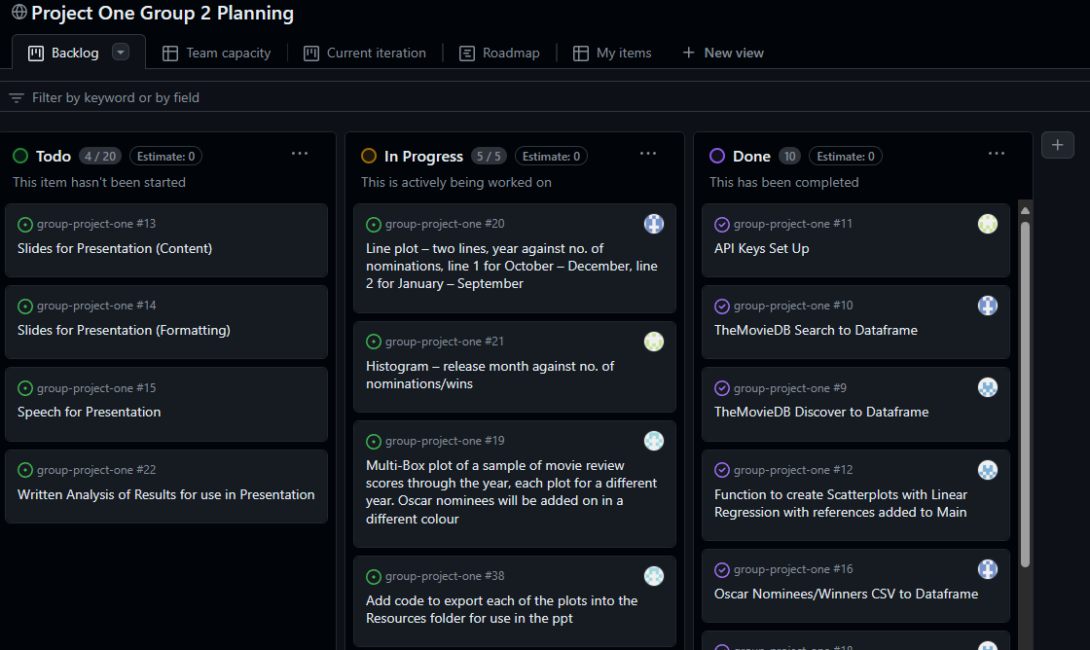
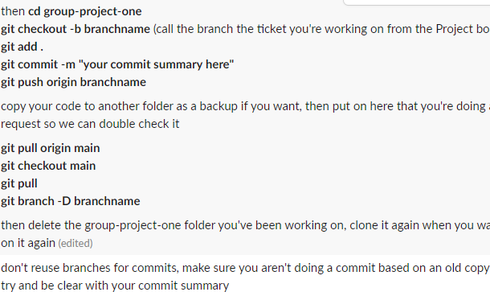
Team Collaboration
Agile Project Management
Establish commit policy
Notes:
We’ll keep this section quick, but this is how we collaborated as a team, we used a Slack group chat to keep in touch and help each other out. We also set up a project board on Github to break down tasks into more manageable tickets and avoid double handling of tasks. Finally we established a policy for commits. As we’re all very new to this way of working, a commit policy meant we were all on the same page, and any code could be checked by others in the group to avoid merging issues and bugs.

Slide 7
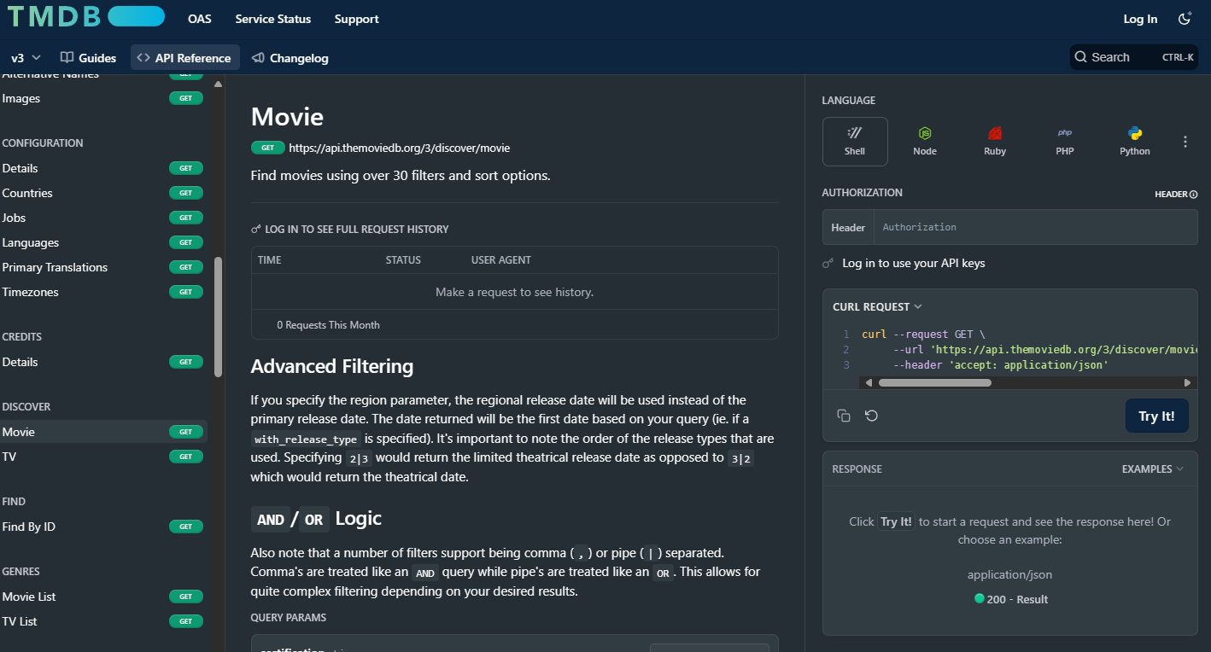
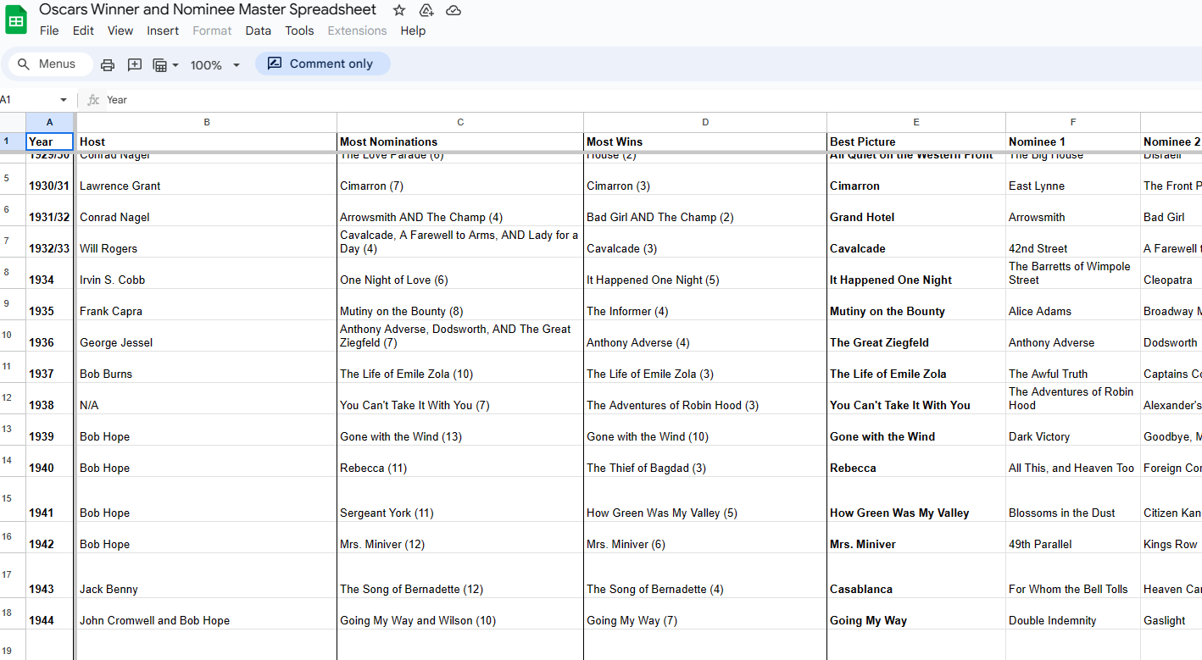
Data Sources
developer.themoviedb.org
Oscars Winner and Nominee Master Spreadsheet - Google Sheets
Notes:
To collect our data, we looked at several options, but settled on TheMovieDB’s exceptional developer API tools to extract movie information, release dates and review scores. For our purposes, we will be considering only the top 10% most reviewed movies from each year, which we have found allowed our visualisations to be more readable, whilst maintaining accuracy. We also found a publicly accessible list of Oscar Winners and Nominees on a Google Sheet, which we saved as a CSV and used to cross reference the information from the API and add whether it was nominated for an Oscar. As a limitation of our research, Covid-19 meant significant changes to the format of the Oscar Awards between 2020 and 2023, so we chose to avoid those years for our data collection.
I’ll now pass you to Daniel to discuss our first two visualisations for our first hypothesis

Slide 8
Hypothesis 1:
If a movie is released within two months of the nominations closing, it is more likely to be nominated

Slide 9
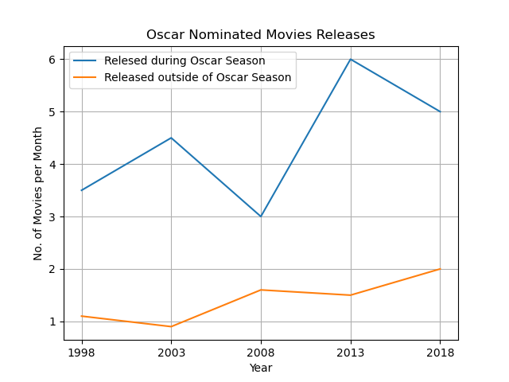
Multi-Line Plot
More nominated movies are released during “Oscar Season”
Strategic releases
Fresher in the minds of voters
Effect of streaming services?
Notes:
Multi Line Plot
Across all years tested, more nominated movies are released during “Oscar season”.
This is most likely due to the fact that these films are fresher in the mind of the Academy voters.
Limited and strategic releases may also be a factor; some films are shown exclusively to the academy before being opened up to a limited release right before Oscar Season.
Does streaming have an impact?
With the advent of streaming services like Netflix, Amazon Prime, Disney Plus etc., is there an impact on the number of people going out to see movies at the box office?
There has also been an increase of films released direct to streaming, completely bypassing the movie-going audience.

Slide 10
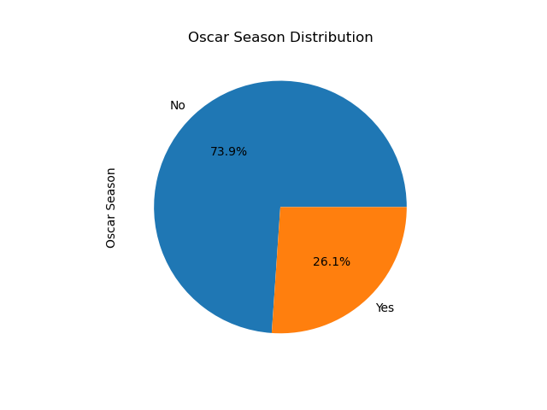
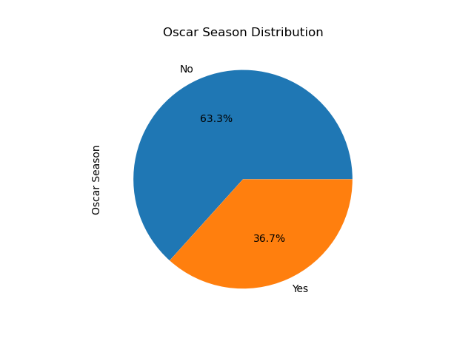
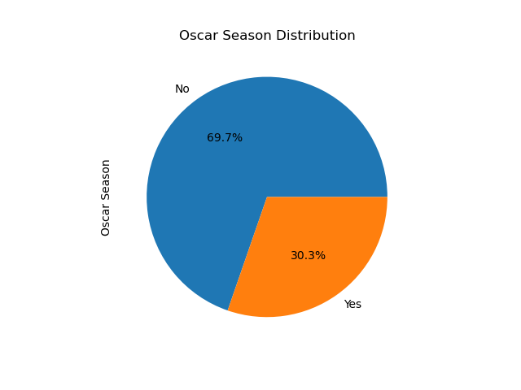
Pie Chart – Oscar Season stats
2008 – 56% increase above average
2013 – 119% increase above average
2018 – 81% increase above average
Notes:
We can see from the pie chart displayed, that in 2013, 30.3% of the Oscar Nominated movies released in November and December. compared to 63.3% of movies released in the rest of the month. These 2 months only take up 16.7% of the year yet contain a lot of nominated films. This means that generally, films released in November or December are significantly more likely to be nominated.

Slide 11
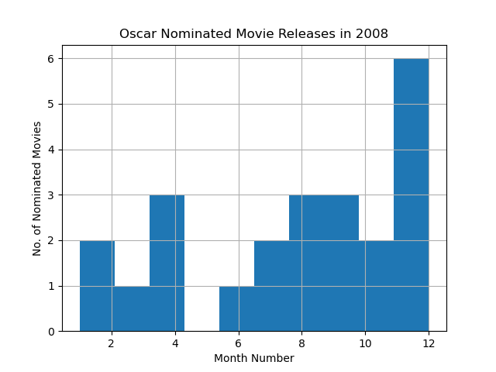
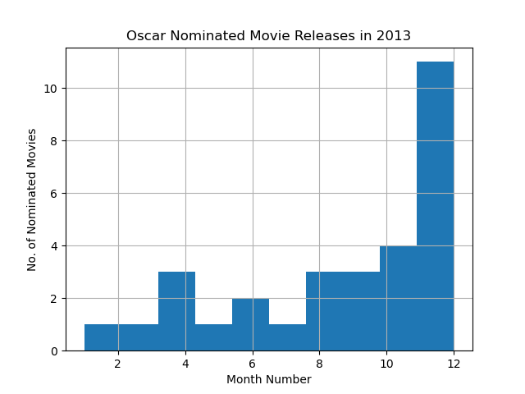
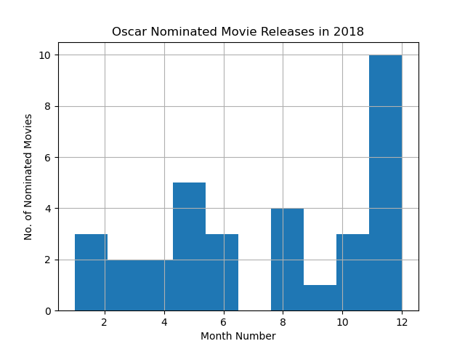
Histogram
2008 – 6 in December
2013 – 11 in December
2018 - 10 in December
Notes:
By analysing all three histograms, the common factor shown in these pictures is number of nominations is at the highest for the months of November and December of the chosen years, which means that November and December have the most releases which they showcase and campaign to get a nomination for the Oscars. Another thing which I can relate to with Oscar season and these histograms is: Even though Nov and Dec have the most movies released and showcased, October is the start of the season. In these histograms, you could see October at a number of 2 or 3 nominations followed by a humongous increase of nominations in November or December, which translates to “The Oscar season begins in October with the first batch of releases, which are in small number, followed by a greater number of releases in November and December.” The movies which should be deemed as “Oscar-worthy” are mostly released from October to December to boost or capitalized this season, such that it remains fresh for critics and Academy Awards jury to earn a nomination. Comparing to these histograms, there used to be releases in June to August in 2008, while decreasing to half in 2013, and zero in 2018, which shows the these months are the “dump months”, which means the time period of releases which garners lowered expectations of films.

Slide 12
Hypothesis 2:
If a movie receives high review scores, it is more likely to be nominated

Slide 13
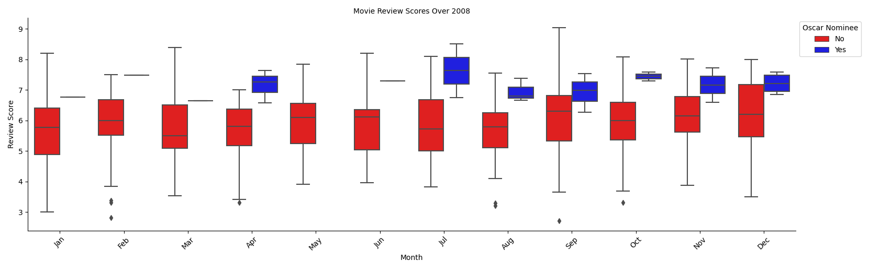
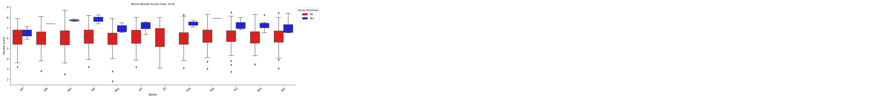
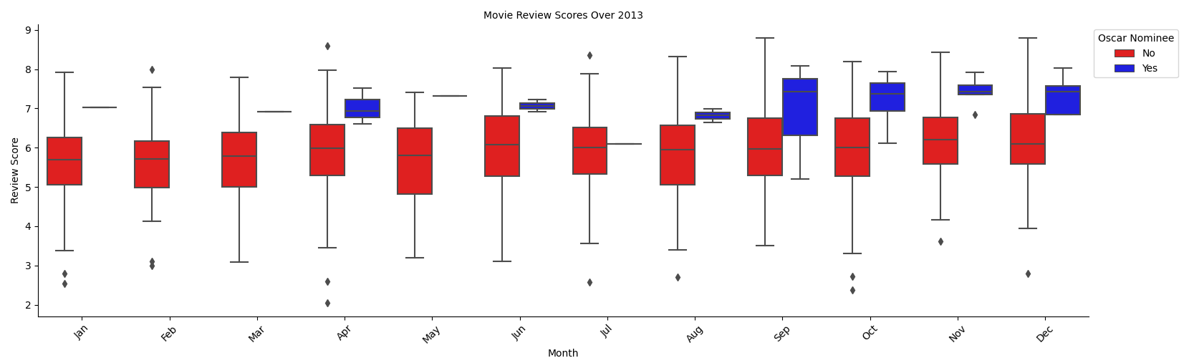
Multi-Box Plot
2008
2013
2018
Notes:
For our Multi-Box Plots, we can see that surprisingly, the review scores for Oscar Nominated movies released in December, shown in blue, are generally lower than those in other months. This could suggest that a lower standard is required for movies released later in the year to be nominated for an Oscar. We can also see from the Red box plots for Non-nominated movies, that there are movies released throughout the year with much higher review scores than those nominated for an award, particularly in the cases of April 2013 and January 2018. This could come down to genre, indicating that studios prefer to release movies of a more serious tone later in the year, which is what we expected to see.
With regards to our hypothesis, these plots appear to disprove our point, suggesting that a higher average review score does not make a movie more likely to be nominated, and goes further to suggest that movies released in December have a lower bar for nomination.

Slide 14
Hypothesis 3:
The later in the year a movie is released, the higher average review scores it will receive.
Notes:
For the third hypothesis of our analysis, we wanted to know if movies released within two months of the Academy Awards Nominations window receive higher review scores than movies released outside of that window, which we simplified to ask whether movies released later in the year receive higher review scores.

Slide 15
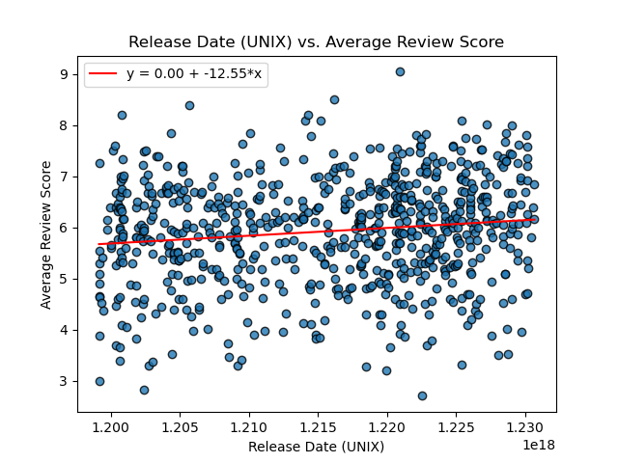
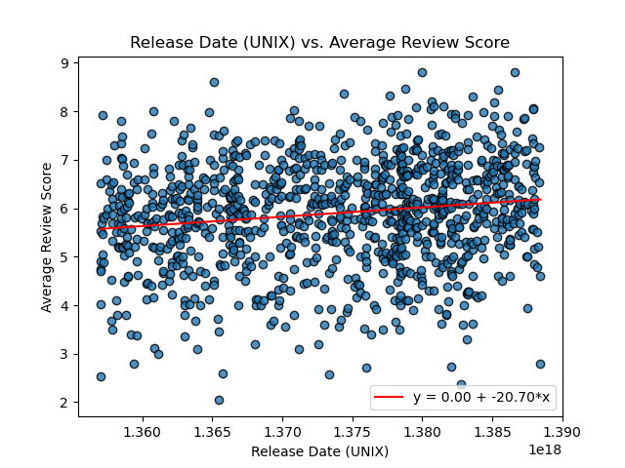
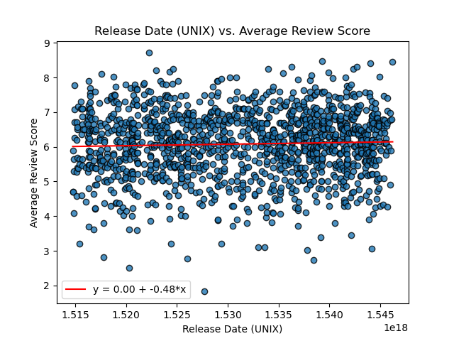
Scatterplot
2008 - The r-value is: 0.13618784692218067
2013 - The r-value is: 0.15815392452964822
2018 - The r-value is: 0.03995487401930444
Notes:
To assess how review scores change over the year, we put the average review score for each movie released throughout the year on to a Scatterplot and then used a linear regression line and the Pearson Correlation Coefficient to statistically prove whether our hypothesis is true. As you can see from the visualisations, although weak, there is a consistent positive correlation between release date and review score. We could attribute this to a variety of factors: Primarily, and something that we have also tested in our other hypotheses, a factor could be that movies released later in the year are better, as studios release their best movies closer to Awards season to have a better chance of winning an award. We should also consider that Journalists may have bias in their reviews though, as they attempt to predict Oscar nominees to improve their reputation as a reviewer.
To improve these plots, we could have removed outliers for a clearer coefficient line, plotted more years to further reinforce our findings regarding the correlation, or used the full population of movies from the selected years to have a complete picture.

Slide 16
Conclusions
Yes, If a movie is released within two months of the nominations closing, it is more likely to be nominated
No, a movie receiving a high review scores does not mean it is more likely to be nominated
Yes, the later in the year a movie is released, the higher average review scores it will receive.
Notes:
It seems clear from the analysis we have done that “Oscar Bait” is a term that both Studios and The Academy take more and more seriously each year. We saw that movies released in November-December are significantly more likely to be nominated for Oscar Awards, a trend that is increasing year on year, but that yearly trends for average movie reviews, whilst indicating that movies released later in the year do receive higher reviews, have not seen a change demonstrating any relation to nominations.

Slide 17

Driving Factor
Notes:
This could suggest that the quality of movies released later in the year is not improving, but the Academy is taking more notice of movies released later in the year and disproportionately nominating them. Our Multi-Box plot displays this clearly, as the box plot for Oscar Nominated movies would tend closer to the average for Non-nominated movies.
Ultimately, this suggests that "Oscar Bait" is not only real, but the Academy themselves are the main force driving it, and studios simply follow the trends to increase their chances of winning.

Slide 18
The Future
Streaming
Changes to the Academy
Unexpected Global Events
Summer Family Blockbusters
Winter Awards Attempts
Notes:
For a final thought, we look to the future, and what we can and cannot model going forward. What we can’t predict, is how Streaming will impact this landscape. We saw the impact it had in 2008 when it was first starting to enter, and although it appears to have balanced out, it could allow a wider range of films, particularly lower budget ones, to compete at the awards. Secondly, the Academy may recognize this trend and choose to put a stop to it, changing the way they do the awards. Finally, and I have to mention it because of the effect it has had on our data and the way we conducted our research, there could be another unexpected global event around the corner that could change things even more.
What we can predict from our results: Under the current model, we can expect more and more “Oscar Bait” movies to be released in November and December each year, and this may mean studios release their lower rated movies in the summer. Over time, this could develop into two clear “Movie Seasons”, a summer season where light-hearted family blockbusters are released, and a winter season where studios make their award attempts.
Thank you for listening.

